Slide 1
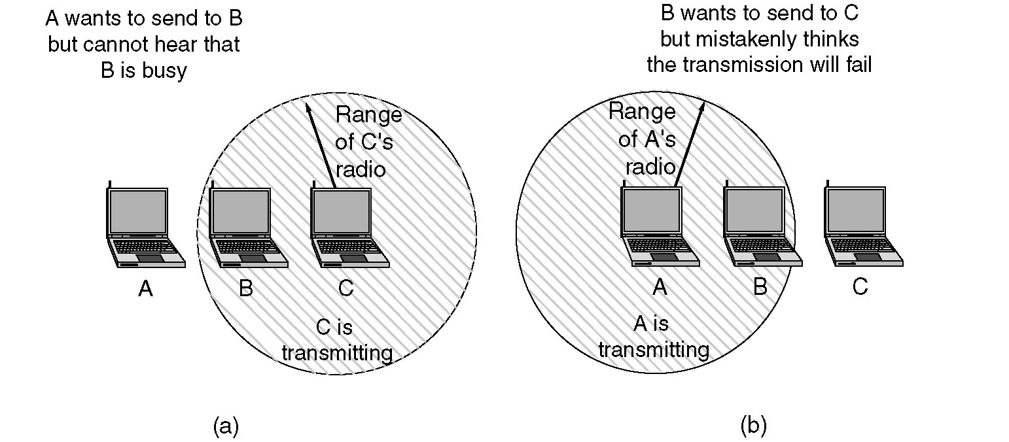
Hidden and Exposed Station Problems
(a) The hidden station problem
(b) The exposed station problem

Slide 2
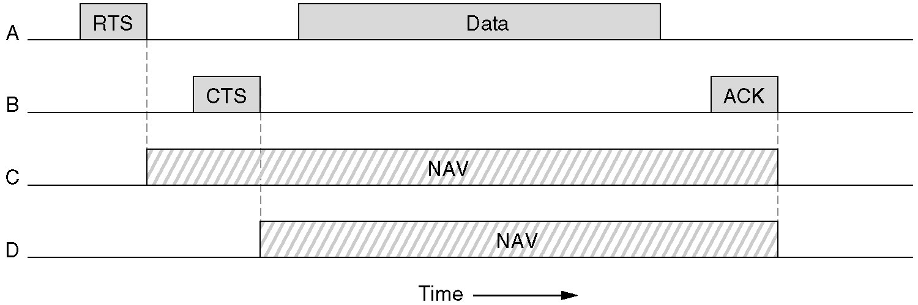
Network Allocation Vector

Slide 3
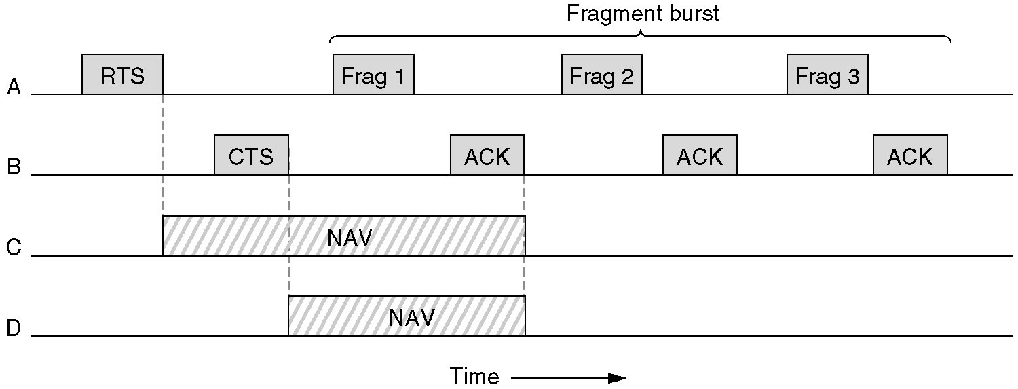
Fragment Burst Example

Slide 4
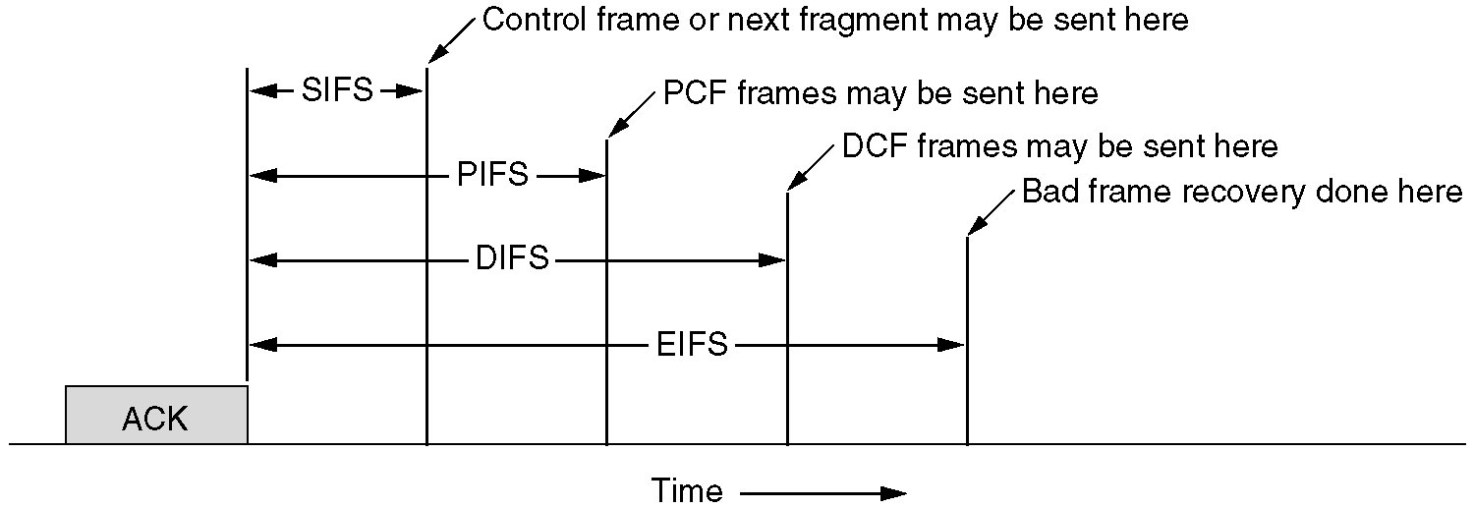
802.11 MAC Sublayer Protocol
Interframe spacing in 802.11

Slide 5
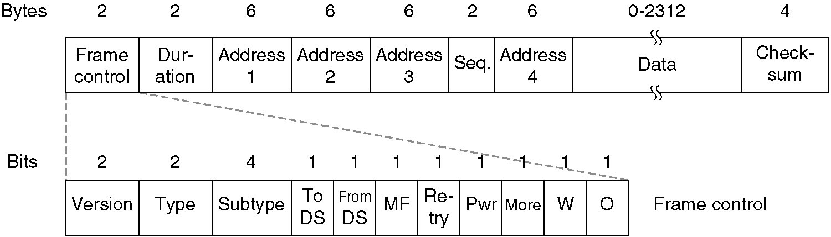
802.11 Data Frame Structure

